Slide 1

Object Oriented Analysis and Design using Java
UE19CS353
Prof. Sindhu R Pai
Department of Computer Science and Engineering

Slide 2

UE19CS353: Object Oriented Analysis and Design using Java
Hands on session – 2: Arrays and Objects
Prof. Sindhu R Pai
Department of Computer Science and Engineering

Slide 3
Object Oriented Analysis and Design using Java
Agenda
Arrays
Problem statements on Arrays
Problem statements on objects

Slide 4
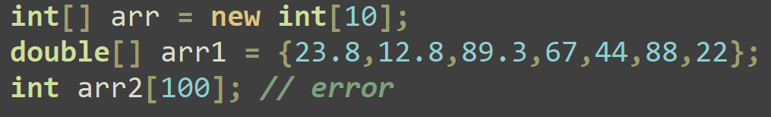
Object Oriented Analysis and Design using Java
Arrays in Java
Derived non-primitive data type
Homogenous in nature
All elements are initialized to 0
Works with index/subscript
datatype[] variable = new datatype[size];
If initial values are known, new must not be used.

Slide 5
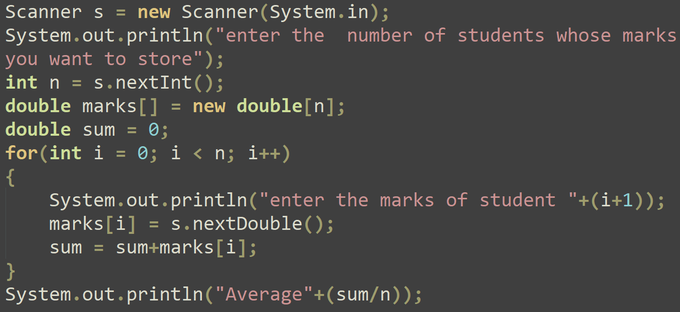
Object Oriented Analysis and Design using Java
Demo of Array
Read the marks of n students and find the average

Slide 6
Object Oriented Analysis and Design using Java
Problem statements on Arrays
Read a set of numbers and a number x. Find out how many times x is present in the set
Check if two given sets/list of numbers are disjoint.
Find out the first repeated element in an array of integers.
Find the closest pair from the two sorted arrays for the given number x.
First array contains 1,4,5,7. Second array contains 10,20,30,40 and x is 31.
Output: (1,30)
For each value of x varying from o to n, store y in an array where y = x2+2x+3

Slide 7
Object Oriented Analysis and Design using Java
Problem statements on objects
Create a class called Employee that includes three pieces of information as instance variables—a first name (typeString), a last name (typeString) and a monthly salary (double). Your class should have a constructor that initializes the three instance variables. Provide a set and a get method for each instance variable. If the monthly salary is not positive, set it to 0.0. Write a test application named EmployeeTest that demonstrates class Employee’s capabilities. Create two Employee objects and display each object’s yearly salary. Then give each Employee a 10% raise and display each Employee’s yearly salary again.

Slide 8
Object Oriented Analysis and Design using Java
Problem statements on objects
Create a Triangle entity with following attributes and functionalities
Sides of the triangle
Find whether triangle can be formed or not
All sides must be greater than 0
Sum of two sides must be greater than the other side
Find the area
Find the perimeter
Find whether two triangles are equals or not
Provide facilities for changing the sides of the triangle individually after creation of it

Slide 9
Object Oriented Analysis and Design using Java
Problem statements on objects
Create an abstract data type Account. Add attributes and functionalities
Account_number
Account_holder name
balance
Account nominee – Think whether it is required..!!
Add debit, credit and get_balance functions
Debit is the one that withdraws money from an Account. Ensure that the debit amount does not exceed the Account’s balance. If it does, the balance should be left unchanged and the method should print a message indicating ―Debit amount exceeded account balance.

Slide 10
Problem statements on objects
Create a class called Invoice that a hardware store might use to represent an invoice for an item sold at the store. An Invoice should include four pieces of information as instance variables‐a part number(type String),a part description(type String),a quantity of the item being purchased (type int) and a price per item (double). Your class should have a constructor that initializes the four instance variables. Provide a set and a get method for each instance variable. In addition, provide a method named getInvoice_ Amount that calculates the invoice amount (i.e., multiplies the quantity by the price per item), then returns the amount as a double value. If the quantity is not positive, it should be set to 0. If the price per item is not positive, it should be set to 0.0. Write aclient application named InvoiceTest that demonstrates class Invoice’s capabilities.
Object Oriented Analysis and Design using Java

Slide 11
Object Oriented Analysis and Design using Java
Problem statements on objects
Create a class called Book to represent a book. A Book should include four pieces of information as instance variables‐a book name, an ISBN number, an author name and a publisher. Your class should have a constructor that initializes the four instance variables. Provide a mutator method and accessor method (query method) for each instance variable. In addition, provide a method named getBookInfo that returns the description of the book as a String (the description should include all the information about the book). You should use this keyword in member methods and constructor. Write a test application named BookTest to create an array of object for 30 elements for class Book to demonstrate the class Book's capabilities.

Slide 12
THANK YOU
Sindhu R Pai
Department of Computer Science and Engineering
sindhurpai@pes.edu
+918277606459

